Slide 1
Cosmos Bank Cyber Attack (2018)
Presented by: N. Govardhan Reddy
Reg no: 192411137
Course: Ethical Hacking (ITA1411)

Slide 2

Introduction
The Cosmos Bank Cyber Attack occurred in August 2018.
Cybercriminals targeted Cosmos Cooperative Bank, headquartered in Pune, India.
Attackers compromised the bank's ATM payment infrastructure using malware.
Fraudulent transactions were carried out in multiple countries.
Around ₹94 crore was stolen.
It became one of India's most significant banking cybercrime cases.

Slide 3

Background of the Case
Target
Cosmos Cooperative Bank Ltd., Pune, Maharashtra.
Other parties involved
International cybercriminal network
Money mules who withdrew cash from ATMs
Indian and international banking/payment infrastructure
Pune Police Cyber Crime Cell and other investigating agencies
The attackers reportedly used a coordinated international operation to execute fraudulent ATM withdrawals in a very short period.

Slide 4
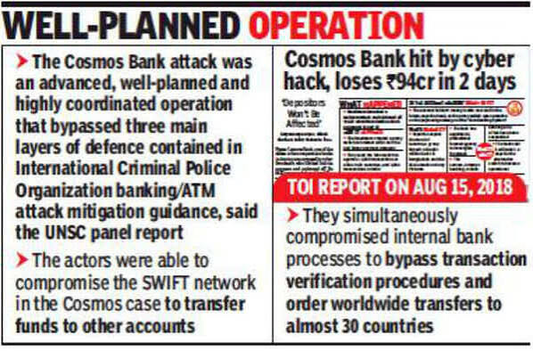
Incident
The attack took place mainly on 11 and 13 August 2018.
Attack flow:
Malware Attack → Payment System Compromised → Fake Transaction Approvals → Thousands of ATM Withdrawals → Money Transferred
Attackers compromised the bank's payment infrastructure.
Fraudulent ATM transactions were authorized.
Cash was withdrawn using cloned cards in different countries.
A fraudulent SWIFT transfer was also made.
The total loss was approximately ₹94.42 crore.

Slide 5

Cybercrime / Legal Issues
The case involved multiple types of cybercrime:
Unauthorized access to banking computer systems
Hacking and malware attacks
Computer-related fraud
Identity and card-data misuse
Unauthorized electronic financial transactions
International cybercrime
Money laundering through money mules
The attack demonstrated how cybercriminals can combine technical hacking with organized financial crime.

Slide 6
Relevant IT Act Sections
The following provisions of the Information Technology Act, 2000 are relevant to conduct of this nature:
Section | Relevance
Section 43 | Unauthorized access, damage, or interference with computer systems
Section 66 | Computer-related offences committed dishonestly or fraudulently
Section 66C | Identity theft and misuse of electronic credentials
Section 66D | Cheating by personation using computer resources
Section 72 | Breach of confidentiality and privacy

Slide 7

Investigation and Evidence
The investigation involved:
Analysis of ATM transaction records
Examination of bank server and network logs
CCTV footage from ATM locations
Tracking of suspicious bank accounts and money trails
Identification of people who withdrew and transferred stolen money
Digital forensic investigation
Cooperation between law-enforcement and financial institutions

Slide 8
Court Decision / Legal Outcome
Multiple suspects were arrested during the investigation.
The case was prosecuted before a court in Pune.
In 2023, 11 accused were convicted in connection with the cyberattack.
The case demonstrated that participants in a cybercrime operation including those involved in handling or withdrawing stolen money can face criminal prosecution.

Slide 9
Impact of the Case
The Cosmos Bank attack was important because it:
Exposed vulnerabilities in banking and payment infrastructure.
Demonstrated the international nature of modern cybercrime.
Highlighted the importance of real-time fraud detection.
Increased awareness about cybersecurity in the Indian banking sector.
Showed the need for stronger monitoring of unusual transactions.
Demonstrated the importance of digital evidence in cybercrime investigations.

Slide 10
Lessons Learned & Conclusion
Lessons Learned:
Banks need strong cybersecurity and real-time monitoring.
Regular security updates and audits are essential.
Quick incident response can reduce financial losses.
International cooperation is important in cybercrime investigations.
Conclusion: The Cosmos Bank Cyber Attack showed how a sophisticated cyberattack can cause huge financial losses. It highlighted the importance of strong cybersecurity, digital investigation, and effective cyber laws in protecting the banking sector

Slide 11
THANK YOU

Slide 12
CASE STUDY ON VULNERABILITY CVE-2026-11931(HACKER RANK)
Q1. Organization Name
Amazon Web Services (AWS) – Kiro IDE
Q2. Vulnerability Title
CVE-2026-11931 – Authentication Tokens Stored with 0644 Permissions
Q3. Vulnerability Category
CWE-732: Incorrect Default Permissions
Severity: Medium
CVSS: 5.5
Q4. Brief Description
Kiro IDE stored access and refresh tokens in a plaintext JSON file with 0644 permissions, allowing local users to read the file.

Slide 13
Q5. Security Impact
Token theft
User impersonation
Unauthorized API access
Misuse of AWS services
Q6. Disclosure Process
Researcher reported privately to AWS VDP.
AWS validated and fixed the issue.
Patched in Kiro IDE v0.11.133.
Q7. Responsible Disclosure
Yes. AWS was informed before public disclosure.
Q8. Was Full Disclosure Dangerous?
Yes. Attackers could have stolen authentication tokens before a fix.
Q9. Lessons Learned
Store credentials securely.
Use 0600 permissions.
Apply least privilege.
Use secure credential storage.
Q10. Conclusion
A file permission mistake exposed sensitive tokens. Responsible disclosure and timely patching reduced the security risk.

Slide 14
ACTIVITY-2 :CVE Analysis and Responsible Disclosure of CVE-2024-6387 (regreSSHion)
Q1. Introduction
CVE-2024-6387 (regreSSHion) is a Remote Code Execution vulnerability in OpenSSH.
Q2. Vulnerability Description
CVE: CVE-2024-6387
Type: Signal Handler Race Condition
Impact: Remote Code Execution
Authentication: Not Required
Q3. Disclosure Timeline
2006 – Original bug fixed , 2020 – Bug reintroduced
2024 – Rediscovered by Qualys , OpenSSH 9.8 released with fix

Slide 15
Q4. Analysis
Cause: Race condition in signal handling.
Impact: Server compromise, data theft, malware installation.
Q5. Responsible Disclosure Evaluation
Was Responsible Disclosure Followed? Yes. Qualys privately informed OpenSSH developers before public release.
Could Full Disclosure Have Been Dangerous? Yes. Attackers could have exploited unpatched SSH servers.
Q6. Conclusion
Update to OpenSSH 9.8+.
Perform regular patch management.
Restrict SSH access.
Coordinated disclosure improves user security.

